Slide 1


Avanti Pg College
Career Development Drive by Anudip Foundation
A PRESENTATION ON
ATM SYSTEM
DEPARTMENT OF MASTER OF COMPUTER APPLICATIONS(MCA)
Submitted to: Submitted by:
Shamsheera Akhila Vodnala
(Anudip foundation). I’d:AF0400793

Slide 2

CONTENTS
Structure and Functionality
of ATM SYSTEM.
Overview of the project.
ATM System Architecture.
Output of project.
Features of ATM Systems
Conclusion

Slide 3
Structure and Functionality :
Entities and Services :
Entities : The program interacts with several key entities: Bank,Customer,Account,Card,and Transaction. These likely represent database tables,with fields for attributes like bank names,account balances,transaction amounts,etc.
Service : Each entity has a corresponding service class(e.g.,BankService,CustomerService, etc.,),responsible for interacting with the database through a SessionFactory(Hibernate’s session factory for OMR).These service classes enable operations like create ,read, update,delete(CURD).
Hibernate Setup :
The program uses Hibernate for ORM. It establishes a SessionFactory to manage session with database, initialized through the Configuration class (by default using a hibernate.cfg.xml file).
This Setup is essential for interacting with the underlying database tables representing each entity.

Slide 4
Overview of atm system
Bank Management : Users can create, read, update, delete, and list all banks. When creating a bank the program request user intput for bank details (name,id,address,contact).
Account Management : Account operations allow creating, retrieving, updating, deleting, and listing accounts. When creating an account, the program requests the bank ID to associate the account with a specific bank. If the bank is found, the account is created and linked to it.
Customer Management : Similar to bank operations, customers can be created, retrieved, updated, deleted, and listed. Customers have attributes like name, address, and contact information.
Card Management : For cards, users can create, retrieve, update, delete, and list all cards. Creating a card requires entering the card number, associated account ID, card name, and expiry date.
Transaction Management : Transactions can be created, retrieved, updated, deleted, and listed. When creating a transaction, the system records the transaction amount, current date/time, and the account ID associated with the transaction.

Slide 5
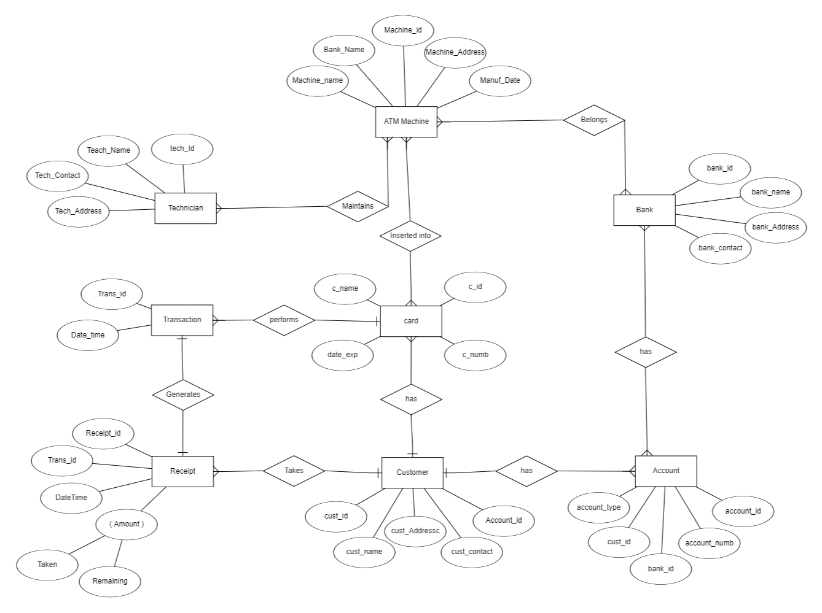
Architecture:

Slide 6
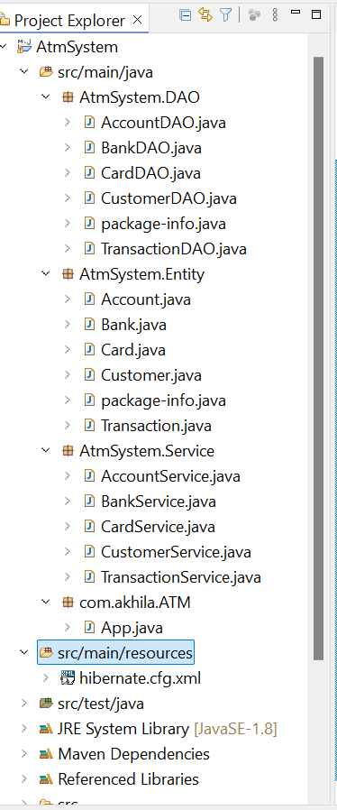
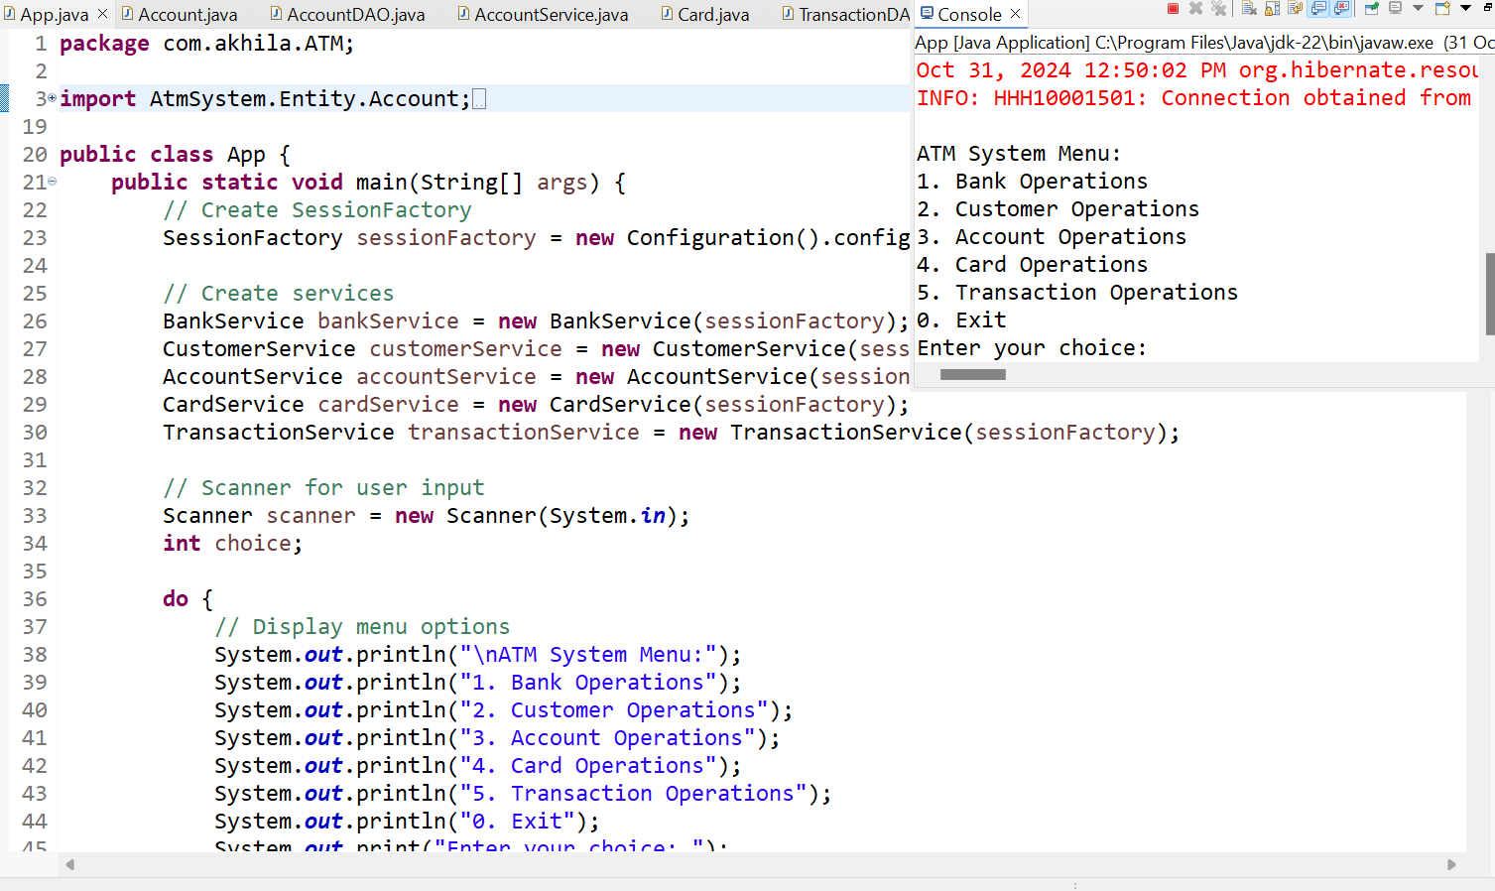
Flow of project and Output:
***Flow of the project ***
ATM System Entities and Hibernate .
***OUTPUT ***
Here the Output represent the:
Atm System Menu
Here we have 5 choice’s that any one option can enter by the user .

Slide 7
Features of atm system :
Authentication
PIN –based security
Encryption:
-Encrypting data transfers between ATMs and bank servers.
Physical Security
-CCTV, anti-skimmimg technology , alarm system.

Slide 8
Conclusion :
This program structure effectively demonstrates how to build a basic Java console application for managing an ATM system, integrating Hibernate for ORM, and providing a user-friendly, menu-driven interface for database operations.
Overall, the program achieves its primary objective of managing various ATM-related entities, providing a foundational structure for more complex ATM functionalities.

Slide 9

THANK YOU!
Akhila Vodnala

